Slide 1
PRECISION AYURVEDIC MEDICINE PREDICTION
JAIKARTHIK.M 2013103616
SHRUTHI.S 2013103069
SHIFANA BEEVI.S 2013103604
UNDER THE GUIDANCE OF
DR.AROCKIA XAVIER ANNIE,
ASSOCIATE PROFESSOR,
COMPUTER SCIENCE DEPARTMENT,
CEG,ANNA UNIVERSITY,
CHENNAI-25

Slide 2
INTRODUCTION:
Chronic disease has been the number one cause of death as well as a disability in India with the host of immune and lifestyle disorders, cardio-vascular problems and so on.
As a complement to modern medicine's approach on treating such illnesses at the symptomatic level, Precision Ayurvedic Medicine Prediction with its focus on “root cause” treatment by identifying the body type(Vata, Pitta, Kapha) and the disease, is an effective and low-cost preventive and curative solution.

Slide 3
OBJECTIVE:
Precision Ayurvedic Medicine Prediction is a model which proposes a usable way of predicting the ayurvedic medicine to be used among patients for their diseases.
Identification of body type: Vata, Pitta, Kapha.
Clustering of data sets.
Disease prediction.
Medicine suggestion.
Herb suggestion.

Slide 4
LITERATURE SURVEY
1. Optimal Drug Prediction From Personal Genomics Profiles
Jianting Sheng, Fuhai Li, and Stephen T. C. Wong
IEEE JOURNAL OF BIOMEDICAL AND HEALTH INFORMATICS, VOL. 19, NO:4, JULY 2015
PURPOSE:
Although sub-typing analysis has identified patient subgroups sharing common biomarkers, there is no effective method to predict the drug response of individual patients precisely and reliably.
FINDING:
The experimental analysis lead to a drug prediction routine that can be used to improve greatly the reliability of finding optimal drugs for individual patients and
will, thus, form a key component in the precision medicine infrastructure

Slide 5
2. Shiva Ayyadurai, V.A. (2014),'The control systems engineering foundation of traditional Indian medicine: the Rosetta Stone for Siddha and Ayurveda', Int. J. System of Systems Engineering ,
Vol. 5, No. 2, pp. 125-149.
FINDING:
1. Health and well-being had to be personalised.
2. The individual Prakriti provides a mechanism to personalise care to find the right therapies that enable the individual to find an optimal of health that may be very different for another individual.

Slide 6
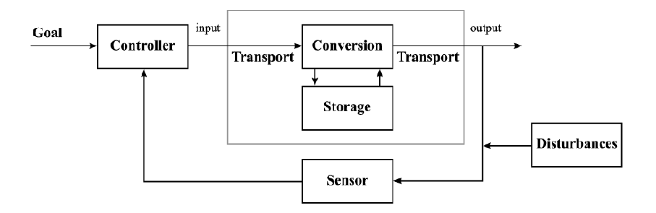
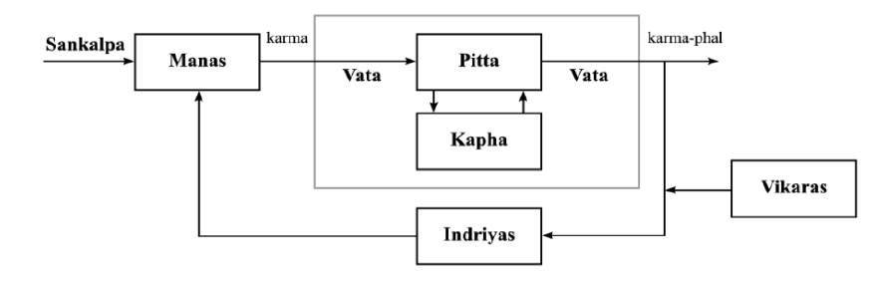
CLOSED LOOP SYSTEM:
REGULATORY CYCLE OF SIDDHA AND AYURVEDA:

Slide 7
S.NO | PAPERS/ARTICLES | PROS | CONS
1 | Chatterjee B, Pancholi J.,Prakriti - based medicine: A step towards personalized medicine. Ayu.2011;32:141–6[PubMed] | Puts forth Ayurveda's holistic approach and its emphasis on prevention and the potential to improve health status. | No systematic integration of Prakriti based medicines yet.
2 | Heather Collins,Sherri Calvo,Kathleen Greenberg, Forman Neall,Stephanie Morrison,Information Needs in the Precision Medicine Era: How Genetics Home Reference Can Help,2016 April | States the importance of research into consumer’s specific information needs which is related to precision medicine that could help guide the evolution of existing educational resources and the development of new resources. | Deals with allopathy and genetic testing and not ayurveda

Slide 8
S.NO | PAPERS/ARTICLES | PROS | CONS
3 | Precision medicine for advanced prostate cancer, Stephanie A. Mullane, Eliezer M. Van Allen, PMC 2016 Jul 21. | The concept of precision medicine driven by body characteristics for Cancer related problems. | The stratification is applicable only for Cancer related problems. Precision medicine is based on allopathy.
4 | Clusters of Ayurvedic Medicines Using Improved K-means Algorithm, Kajal C. Agarwal and Meghana Nagori, ISBN: 978-981-07-5461-7,2013 | This paper discusses the Importance of Ayurveda, standard k-means and improved k-means clustering algorithm and its implementation to form clusters of ayurvedic medicine for diseases. | Automation for chronic diseases are missing.

Slide 9
PROPOSED SYSTEM:
FEATURES:
Quiz to identify body type (Vata, Pitta, Kapha).
Clustering the data sets.
Provided the symptoms, identifying the disease.
Medicine suggestion.
Projecting the ingredients needed to produce those medicines.
Integrating it into a web application using shiny R.

Slide 10
SCOPE OF THE PROJECT:
Precision Ayurvedic Medicine Prediction can be used by any individual all over the world and get to know his/her problems and appropriate solutions.
This project can also be provided to many health care units for quicker response to patients.
When converted to an android app, it becomes easily portable.

Slide 11
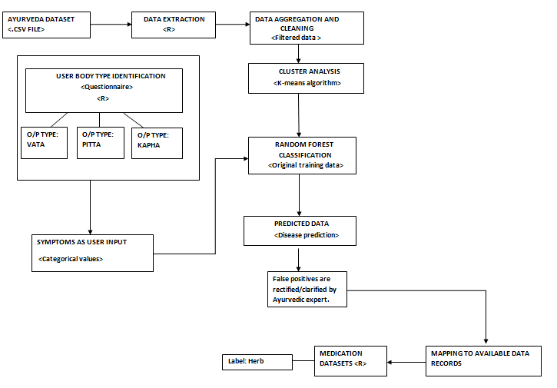
ARCHITECTURE DIAGRAM:

Slide 12
MODULE 1 - IDENTIFICATION OF BODY TYPE:
INPUT:
Answers to physical, mental, fitness and emotional questions.
(Example: Type of Skin, Body weight,etc)
OUTPUT:
Body type. (Vata, Pitta, Kapha).
LANGUAGE:
R language with shiny library.
DETAILS:
1. Questions are posed and each answers corresponding to one particular body type’s score will be incremented.
2. The one with the highest score is the body type.

Slide 13
MODULES SPLITUP
MODULE 2 –
CLUSTERING OF DATA SETS USING K-MEANS ALGORITHM:
INPUT:
Pre-processed datasets.
OUTPUT:
K-number of clusters.
ALGORITHM:
1.Initialize the center of the clusters.
2.Attribute the closest cluster to each data point.
3. Set the position of each cluster to the mean of all data points belonging to that cluster.
4. Repeat steps 2-3 until convergence.
SNIPPET:
k=kmeans(d1[,c(3,4)],78) #kmeans function k$cluster=as.factor(k$cluster)
ggplot(d1,aes(Symptoms,disease,color=k$cluster))+geom_point()

Slide 14
MODULE 3- DISEASE PREDICTION:
This module includes predicting the type of disease from the symptoms.
Normalising the datasets.
Accuracy rates must be analysed.
Ensemble prediction is to be used.
Prediction methods include:
Decision Tree Approach
Ensemble Prediction

Slide 15
1. DECISION TREE ALGORITHM :
DETAILS:
Decision tree is a graph to represent choices and their results in form of a tree.
The nodes in the graph represent an event or choice and the edges of the graph represent the decision rules or conditions.

Slide 16
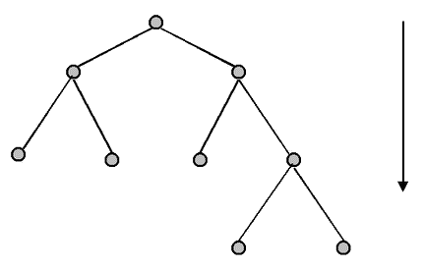
INPUT:
T (Decision Tree)
D (Input database)
OUTPUT:
M (Model prediction)
ALGORITHM:
for each t belongs to D do
n=root node of T
while n not leaf node do
obtain answer to question on n applied t
Identify arc from t which has correct answer
n=node at the end of this arc
Make prediction for t based on labelling of n.

Slide 17
CODE SNIPPET:
training_data=ds
tree_model=rpart(Diseases~.,training_data,method="class", minsplit=2, minbucket=1)
plot(tree_model) #plotting the tree
text(tree_model, pretty = 0) #plot with text
data1=ds[2,1:347]
testing_data=data1
tree_pred=predict(tree_model,testing_data,type="class")
tree_pred
prp(tree_model,tweak=2.7)

Slide 18
2. ENSEMBLE PREDICTION:
An ensemble is a group of predictors each of which gives an estimate of a target variable.
Ensemble learning is a way to combine these predictions with the goal that the generalization error of the combination is lesser than each of the individual predictors.
The success of ensembling lies in the ability to exploit (or inject and exploit) diversity in the individual predictors.
Ensemble methods involve group of predictive models to achieve a better accuracy and model stability. Ensemble methods are known to impart supreme boost to tree based models.
There are 3 ensembling methods.
Bagging
Boosting
Stacking

Slide 19
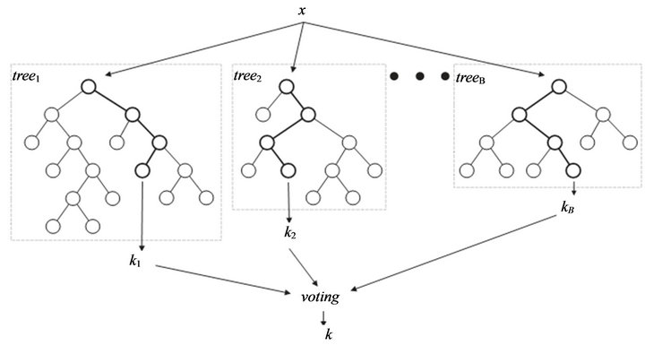
RANDOM FOREST CLASSIFICATION:
INPUT:
Original training data
OUTPUT:
Predicted Data
ALGORITHM:
x<-cbind(x_train,y_train)
output<-randomForest()
summary(output)
predicted=predict(output,x_test)
DETAILS:
Assume number of cases in the training set is N. Then, sample of these N cases is taken at random but with replacement. This sample will be the training set for growing the tree.
If there are M input variables, a number m<M is specified such that at each node, m variables are selected at random out of the M. The best split on these m is used to split the node. The value of m is held constant while we grow the forest.
Each tree is grown to the largest extent possible and there is no pruning.
Predict new data by aggregating the predictions of the ntree trees (i.e., majority votes for
classification, average for regression).

Slide 20
CODE SNIPPET
data<-read.csv("DS1.csv") #loading the data
training_data=data
rfmodel=randomForest(Disease~.,data=training_data,ntree=500,mtry=15,importance=TRUE)
#random forest function call
testing_data1=data[79,1:347]
nos=readline(prompt="Enter number of symptoms:(Upto 4)") #number of inputs
symp1=readline(prompt="Enter symptom:") #Entering the inputs
q=sprintf("SET [%s]='Yes'",symp1)
df=sqldf(c(paste("UPDATE testing_data1",q),"SELECT * FROM testing_data1"))
df1=as.data.frame(df) #updating the symptoms
testing_data=df1
testing_data$predict.rf2=predict(rfmodel,testing_data,type="response")
#predicting the result
result=testing_data$predict.rf2
result=data.frame(result)
result

Slide 21
MODULE 4- MEDICINE SUGGESTION:
INPUT:
Predicted variable.
OUTPUT:
Medicine and herb data.
ALGORITHM:
open medication data sets.
check if rowname=predicted variable
if(yes)
retrieve corresponding column data
else
No medication found.

Slide 22
MODULE 5 - WEB APPLICATION:
The web application module includes identifying the body type of the user using eight fold or ten fold examination.
This will be in the form of quiz by enquiring the user’s physical, mental , emotional and fitness features.
The body type can be either Vata, Pitta or Kapha or it can also be any of the combinations of these three body type.
Based on the body type of the user ,the user will be redirected to a corresponding webpage to input symptoms.
Disease is predicted with the corresponding Ayurvedic treatments and medications.
Web application is developed using shiny R.

Slide 23
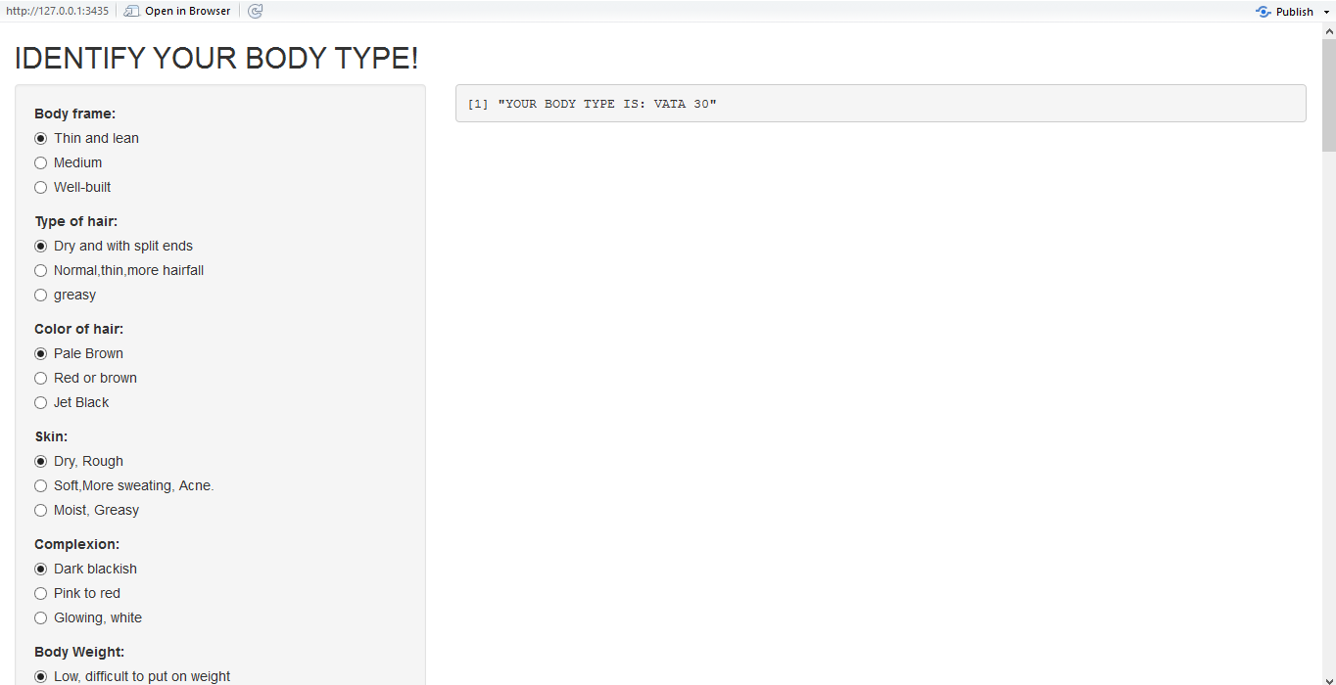
IMPLEMENTATION DETAILS:
A user interface which poses physical, mental and fitness questions with options is developed. The user needs to answer all the questions to identify the body type. This was developed in Rstudio using Shiny library.

Slide 24
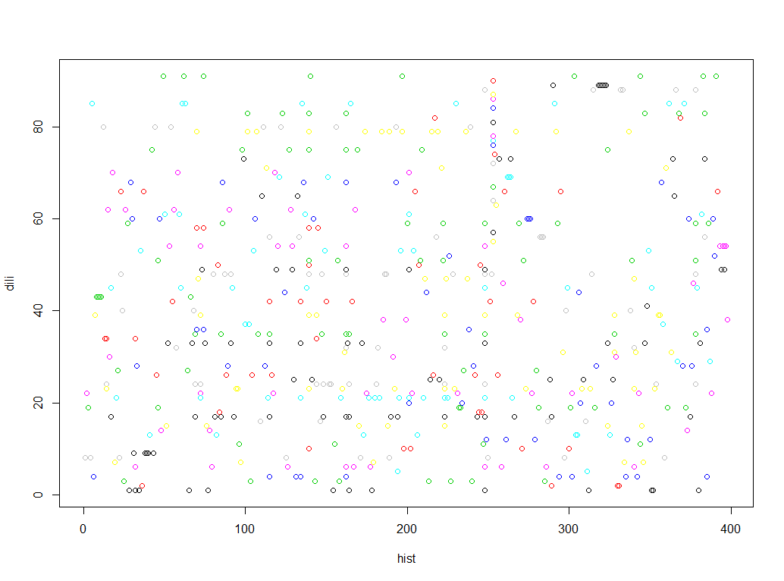
Intermediate result
After Cleaning the data:

Slide 25
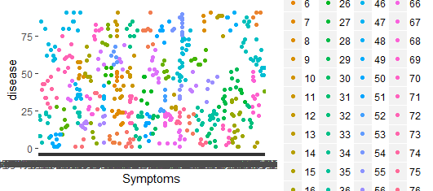
K-Means Clustering:
The datasets have been clustered using K-means algorithm and the clusters are obtained. The clustered image shows the symptoms of a particular disease and many such clusters are formed.

Slide 26
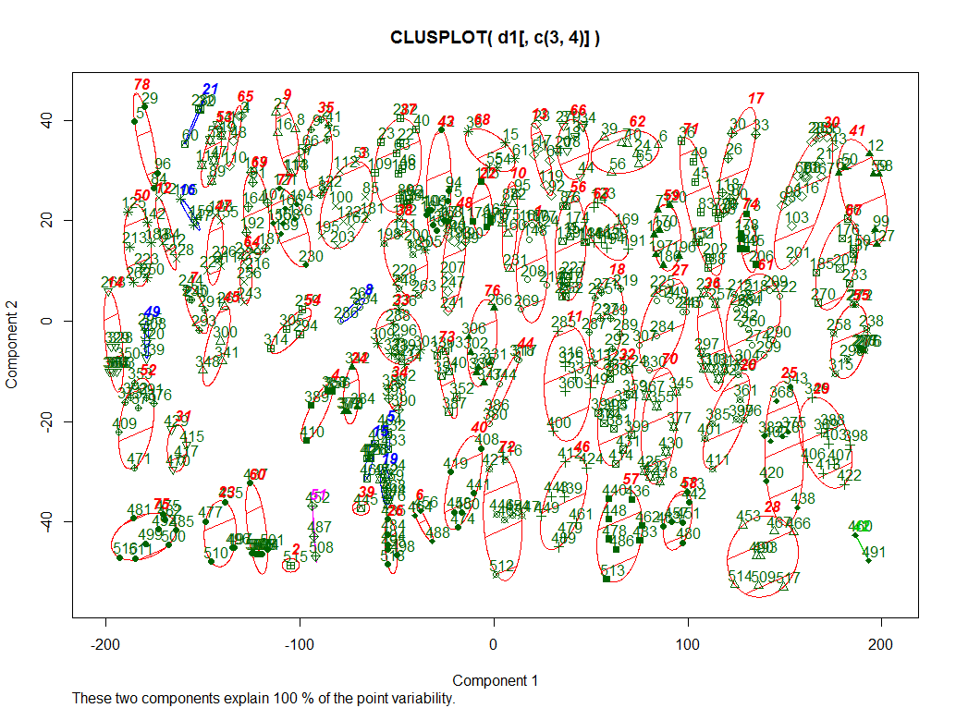

Slide 27
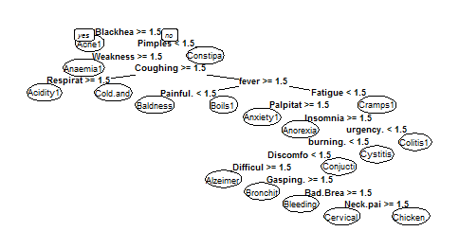
ANALYSIS
Decision tree is a dual class classifier, it can predict only two target variables and our project consists of multiple target variables that is to be predicted.
Didn’t yield desired results

Slide 28

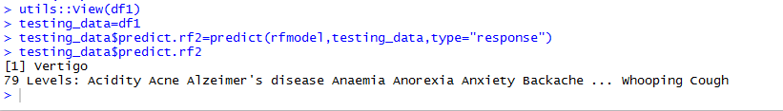
Random Forest:
Symptoms will be entered by the user as per the prompt. The entire dataset is trained using random forest function. The symptoms entered by the user will be made as the test data and the disease will be predicted.

Slide 29
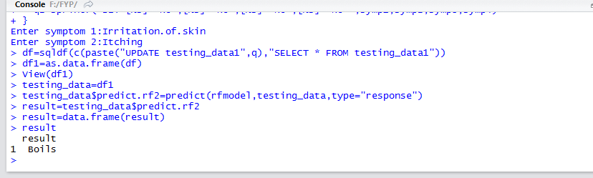
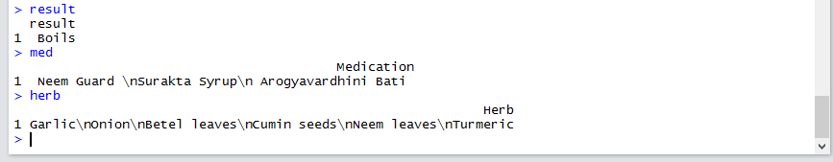
Medicine Suggestion:
From the disease and medication dataset, the medicine for the corresponding disease is identified and displayed.

Slide 30
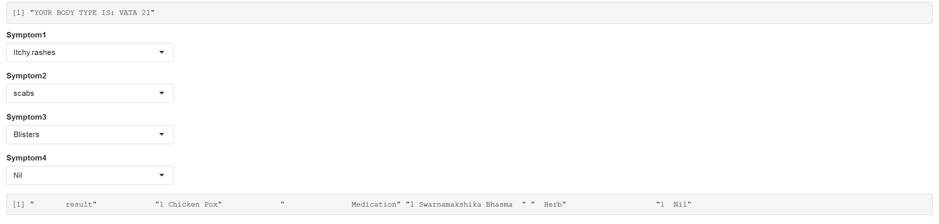
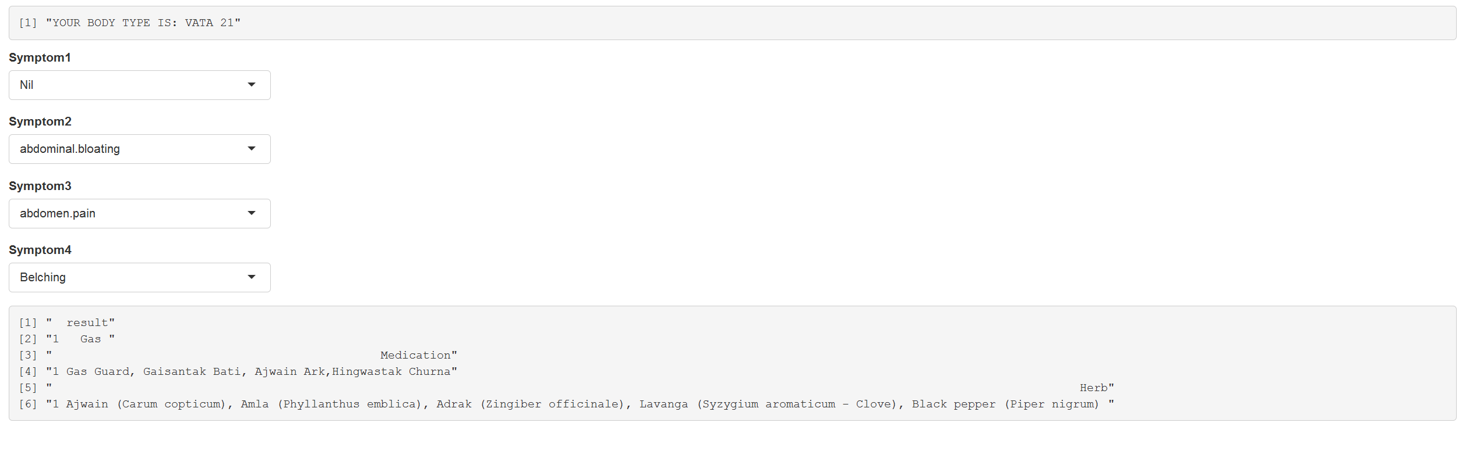
RESULTS

Slide 31
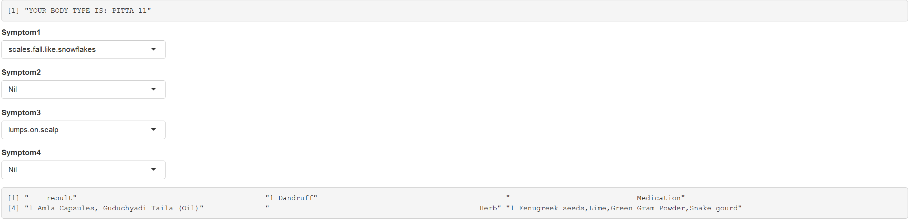
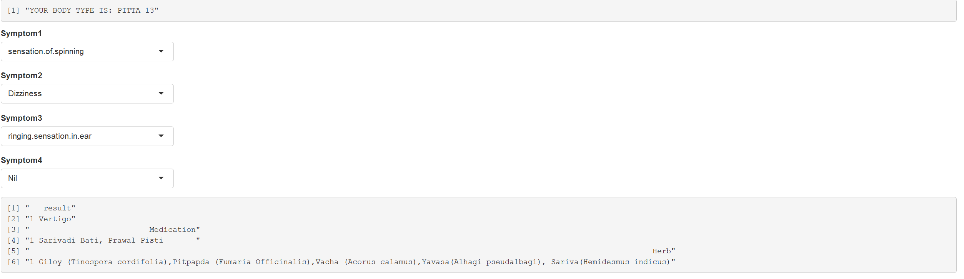

Slide 32
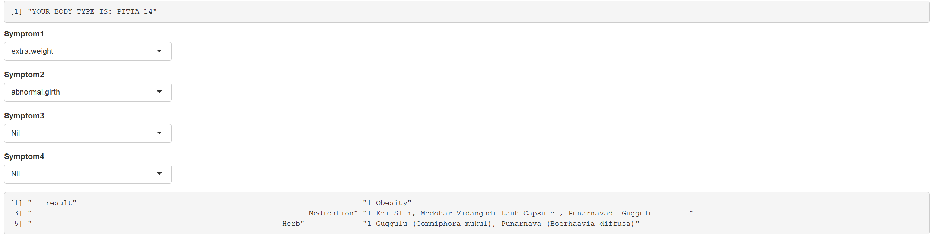
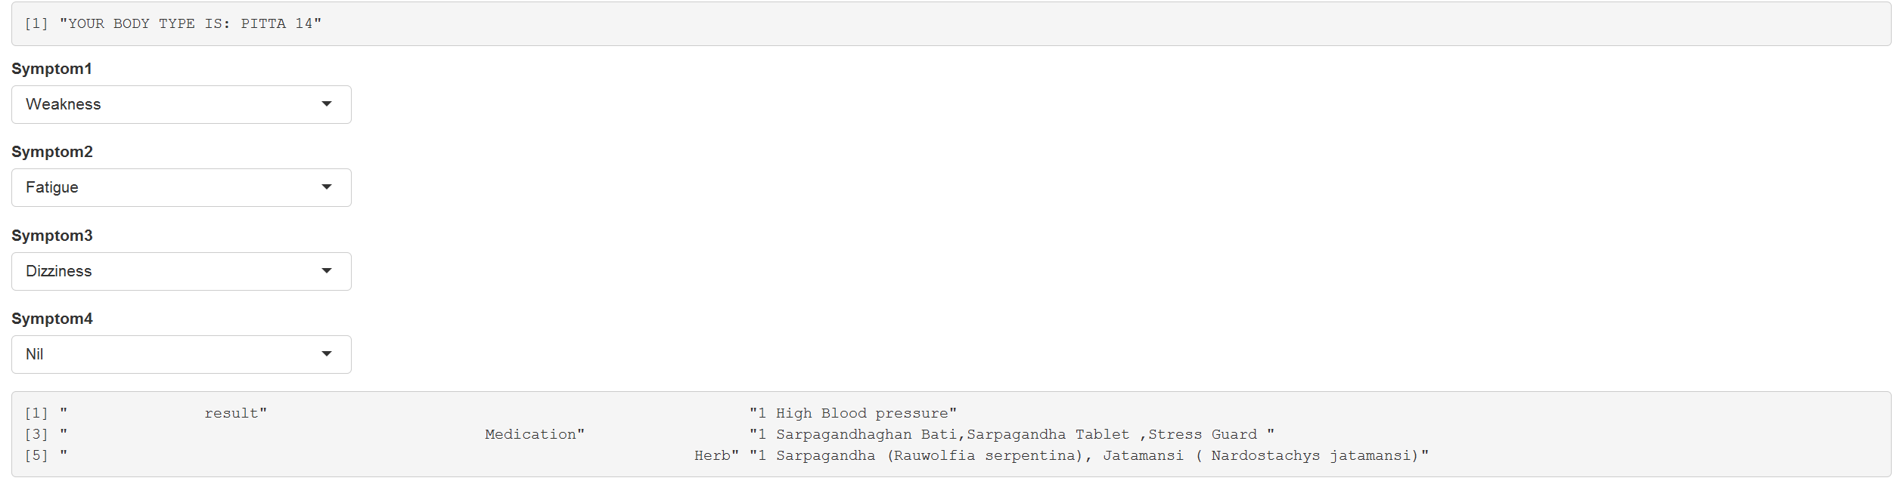

Slide 33
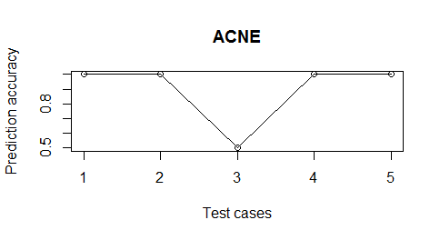
EVALUATION:
Along x-axis:
1 : Four Exact symptoms and correctly predicted disease.
2 : Three correct,one incorrect symptom and correctly predicted disease.
3 : Two correct,two incorrect symptom and correctly predicted disease.
4 : Four incorrect symptom and incorrectly predicted disease
5 : One correct,three incorrect symptom and incorrectly predicted disease.

Slide 34
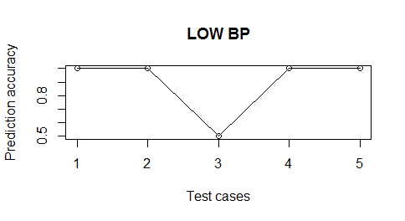
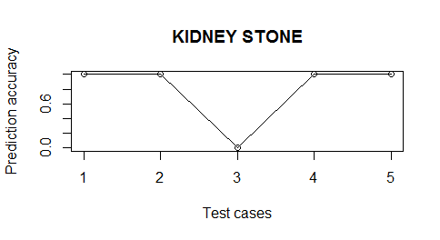
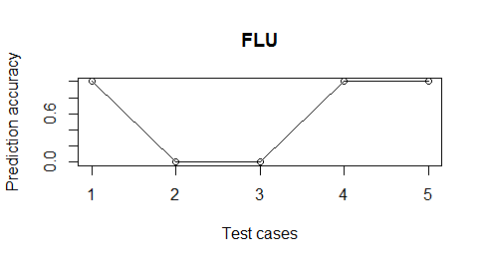

Slide 35
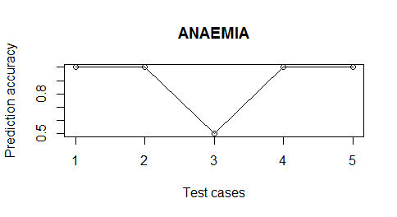
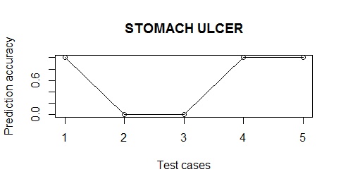
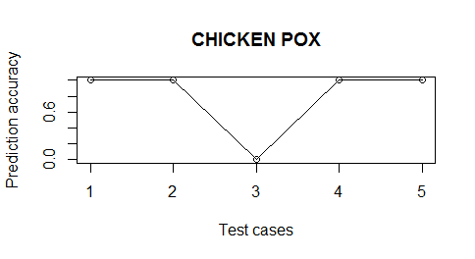

Slide 36
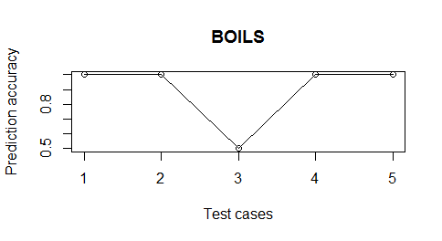
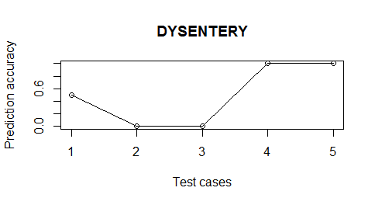
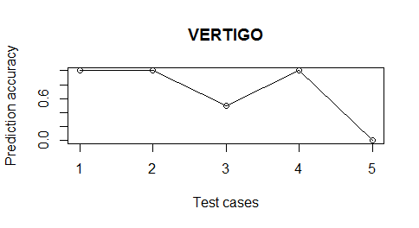

Slide 37

METRICS FOR EVALUATION:
ACCURACY :
Accuracy refers to the closeness of a measured value to a standard or known value. It is the degree to which the result of a measurement, calculation or specification confirms to the correct value or a standard.
Accuracy=∑ R(terms)/ ∑ N(terms)
$$Accuracy=\frac{(9.5+7+2.5+10+9)}{45}$$
$Accuracy=\frac{38 }{45}=0.8444$
ACCURACY=84.4%

Slide 38
DISEASE | Column 1 | Column 2 | Column 3 | Column 4 | Column 5
Acne | 1 | 1 | 0.5 | 1 | 1
Anaemia | 1 | 1 | 0.5 | 1 | 1
Chicken Pox | 1 | 1 | 0 | 1 | 1
Dysentery | 0.5 | 0 | 0 | 1 | 1
Flu | 1 | 0 | 0 | 1 | 1
Boils | 1 | 1 | 0.5 | 1 | 1
Vertigo | 1 | 1 | 0.5 | 1 | 0
Kidney Stone | 1 | 1 | 0 | 1 | 1
Stomach Ulcer | 1 | 0 | 0 | 1 | 1
Low BP | 1 | 1 | 0.5 | 1 | 1
Total | 9.5 | 7 | 2.5 | 10 | 9
Column 1 : Four Exact symptoms and correctly predicted disease.
Column 2 : 3 correct, one incorrect symptom and correctly predicted disease.
Column 3 : Two correct, two incorrect symptom & correctly predicted disease.
Column 4 : Four incorrect symptom and incorrectly predicted disease
Column 5 : One correct,3 incorrect symptom and incorrectly predicted disease.

Slide 39
PRECISION:
Precision refers to the closeness of two or more measurements to each other. Precision is usually expressed in terms of the deviation of a set of results from the arithmetic mean of the set.
PRECISION(Positive)=tp/(tp+fp)
PRECISION(Negative)=fn/(tn+fn)
where
a=true positive
b=false positive
c=true negative
d=false negative

Slide 40
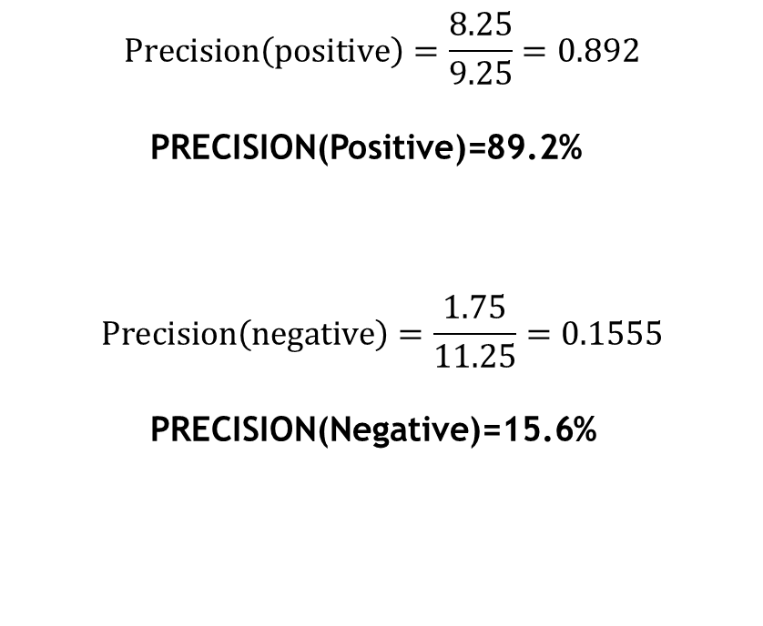
$$Precision\left(positive\right)=\frac{8.25}{9.25}=0.892$$
PRECISION(Positive)=89.2%
$$Precision\left(negative\right)=\frac{1.75}{11.25}=0.1555$$
PRECISION(Negative)=15.6%

Slide 41
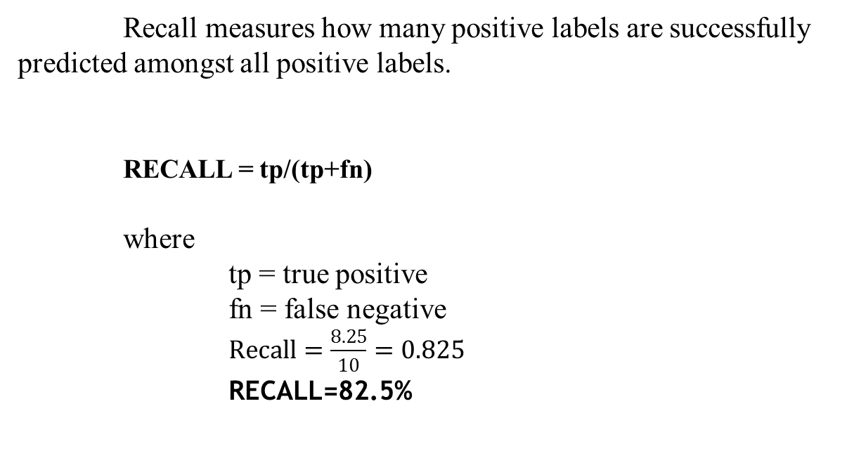
RECALL:
Recall measures how many positive labels are successfully predicted amongst all positive labels.
RECALL = tp/(tp+fn)
where
tp = true positive
fn = false negative
$Recall=\frac{8.25}{10}=0.825$
RECALL=82.5%
F-MEASURE:
A measure that combines precision and recall is the harmonic mean of precision and recall.
F = 2*(Precision * Recall)/(Precision + Recall)
F =2*(89.2*82.5) / (89.2 + 82.5) = 85.7

Slide 42
REFERENCES:
1. J. Sheng, F. Li and S. T. C. Wong, "Optimal Drug Prediction From Personal Genomics Profiles," in IEEE Journal of Biomedical and Health Informatics, vol. 19, no. 4, pp. 1264-1270, July 2015.
2. Shiva Ayyadurai, V.A. (2014),'The control systems engineering foundation of traditional Indian medicine: the Rosetta Stone for Siddha and Ayurveda', Int. J. System of Systems Engineering , Vol. 5, No. 2, pp. 125-149.
3. Chatterjee B, Pancholi J. Prakriti-based medicine: A step towards personalized medicine. Ayu. 2011;32(2):141-146.

Slide 43
REFERENCES:
4. Collins H, Calvo S, Greenberg K, Forman Neall L, Morrison S. Information Needs in the Precision Medicine Era: How Genetics Home Reference Can Help. Eysenbach G, ed. Interactive Journal of Medical Research. 2016;5(2):e13.
5. Mullane SA, Van Allen EM. Precision medicine for advanced prostate cancer. Current opinion in urology. 2016;26(3):231-239.
6. Kajal C. Agarwal, Meghana Nagori, Clusters of Ayurvedic Medicines Using Improved K-means Algorithm, Proc. of the Intl. Conf. on Advances in CSEE 2013

Slide 44
REFERENCES:
7. Gadgil VD. Understanding Ayurveda. Journal of Ayurveda and Integrative Medicine. 2010;1(1):77-80.
8. Banerjee S, Debnath P, Debnath PK. Ayurnutrigenomics: Ayurveda-inspired personalized nutrition from inception to evidence. Journal of Traditional and Complementary Medicine. 2015;5(4):228-233.
9. Banu, MA Nishara, and B. Gomathy. "Disease Predicting System Using Data Mining Techniques." International Journal of Technical Research and Applications 1.5 (2013): 41-45.

Slide 45
REFERENCES:
10. Trivedi, Shubhendu, Zachary A. Pardos, and Neil T. Heffernan. "The Utility of Clustering in Prediction Tasks." arXiv preprint arXiv:1509.06163 (2015).
11. Taneja, Abhishek. "Heart disease prediction system using data mining techniques." Orient. J. Comput. Sci. Technol (2013).
12. Friedman, Nir, Dan Geiger, and Moises Goldszmidt. "Bayesian network classifiers." Machine learning 29.2-3 (1997): 131-163.

Slide 46
REFERENCES:
13. Kohavi, Ron. "Scaling Up the Accuracy of Naive-Bayes Classifiers: A Decision-Tree Hybrid." KDD. Vol. 96. 1996.
14. Liaw, Andy, and Matthew Wiener. "Classification and regression by randomForest." R news 2.3 (2002): 18-22.

